Slide 1
FDA Drugs Analysis
-Narayan patil

Slide 2
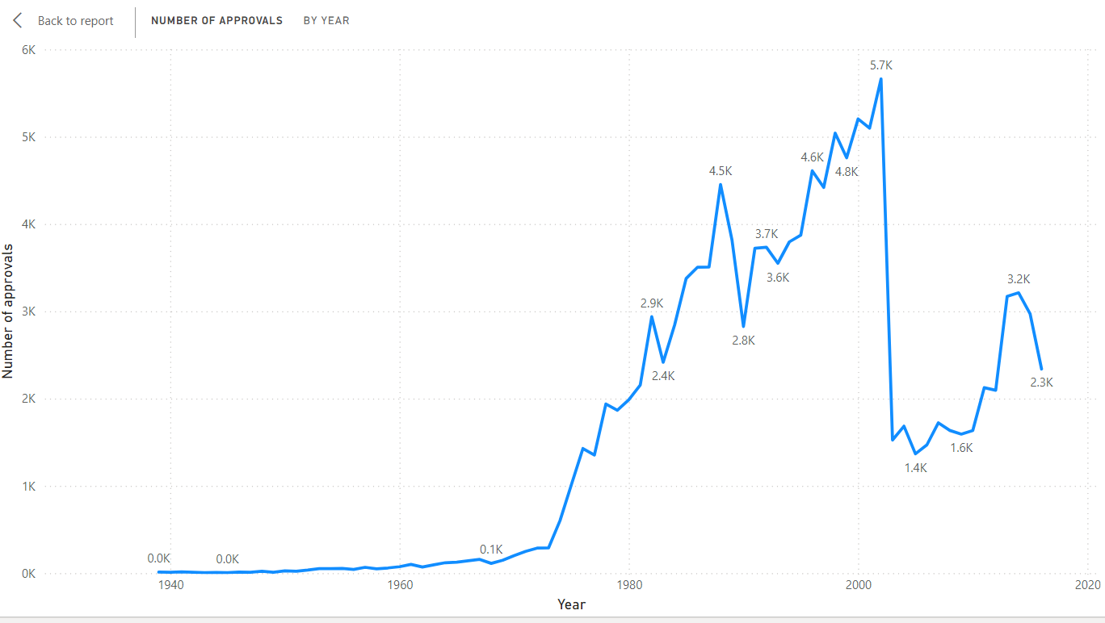
No of Approvals by Year
As per data it is observed that 2002 has had the most approvals i.e 5662 nos
Post 1973 the approvals garnered pace which steeply fell in 2003

Slide 3
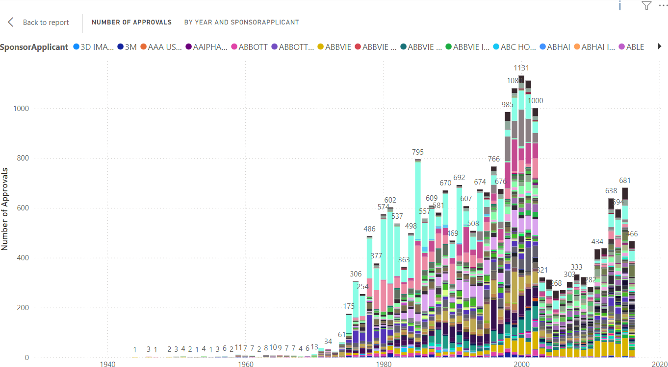
No of Approvals by Year and Sponsor applicant
As per data it is observed that in year 2001 majority of sponsors have had their products approved

Slide 4
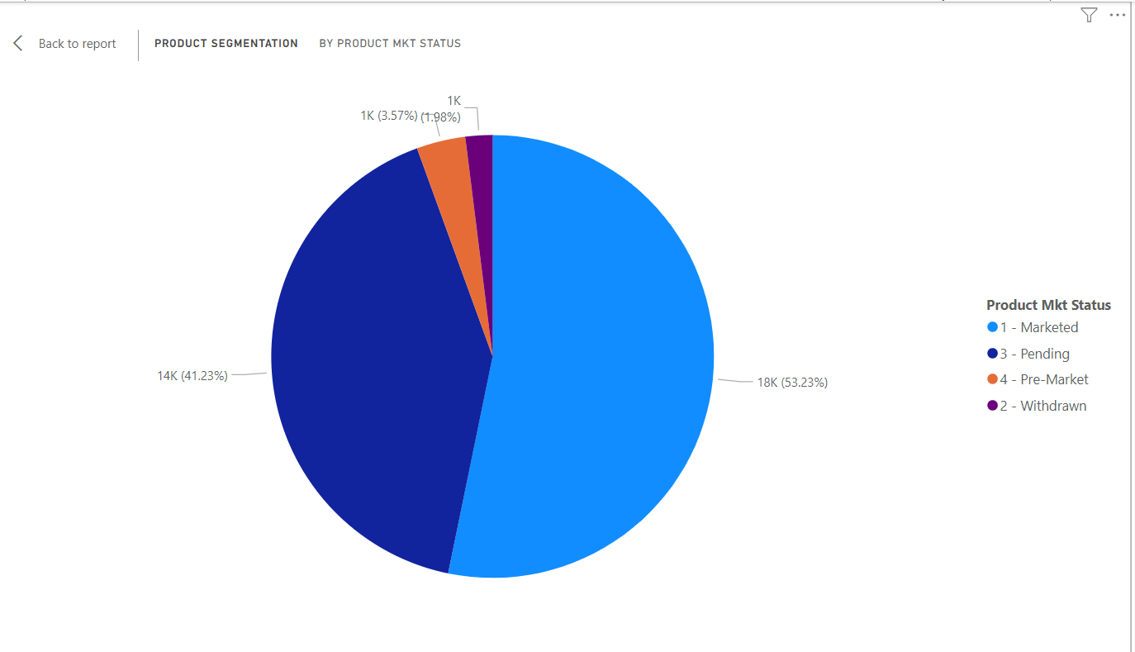
Segmentation of products based on Marketing Status
From the data is understood that 53.23% of the products in the database are Currently on market and available
Also it is alarming that 41.23% of the Products are pending for approvals and need to be looked upon

Slide 5
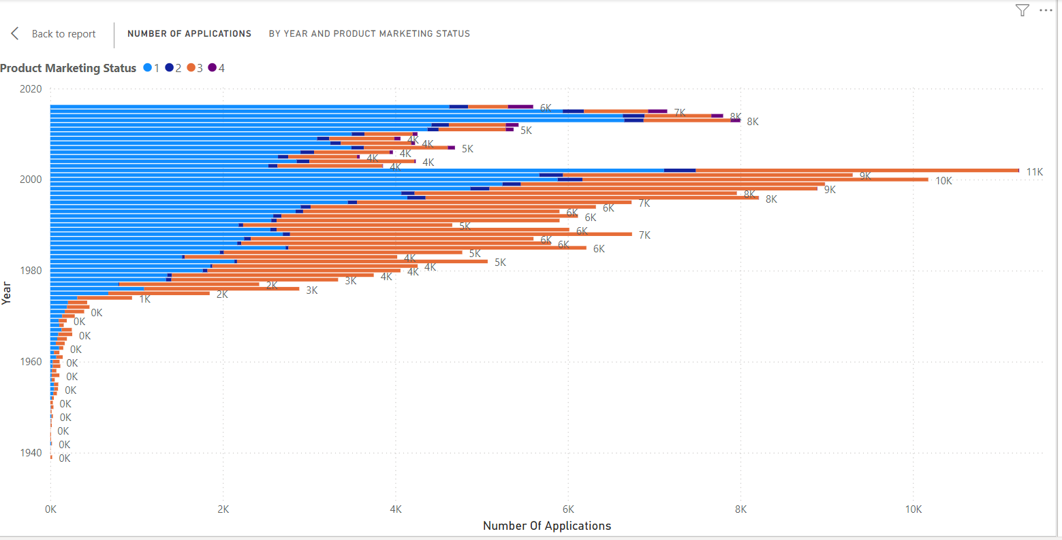
Total Number Of Applications for each Marketing Status Year Wise
The trend shows that post 2002 majority of the products in FDA database were cleared for market release
It is good to see that the FDA has done significant improvements post 1976 by increasing the no of approvals

Slide 6
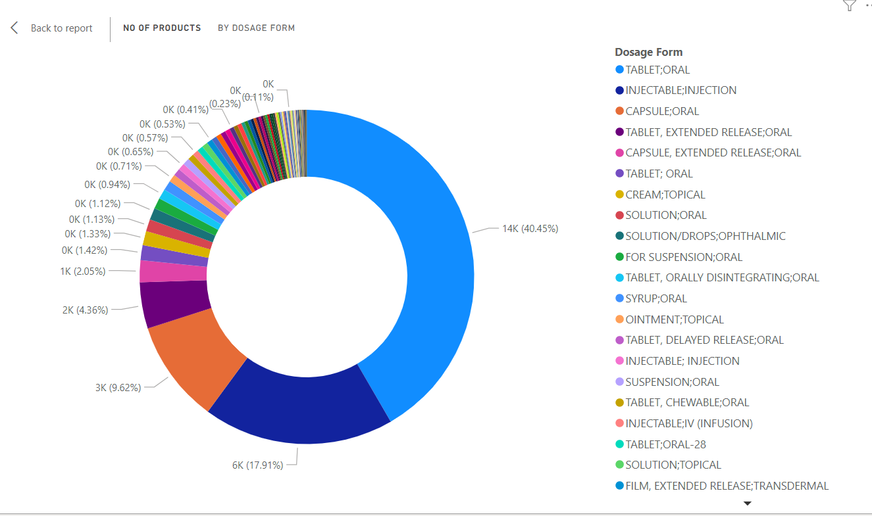
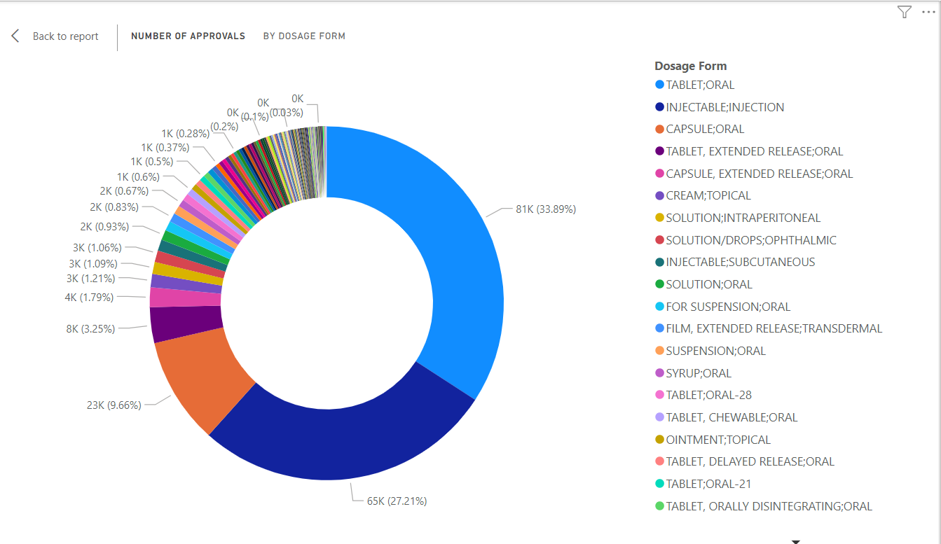
Dosage form Insights
From The trend it is clear that majority prefer Tablets as an ideal dosage form which makes it the most famous dosage type

Slide 7
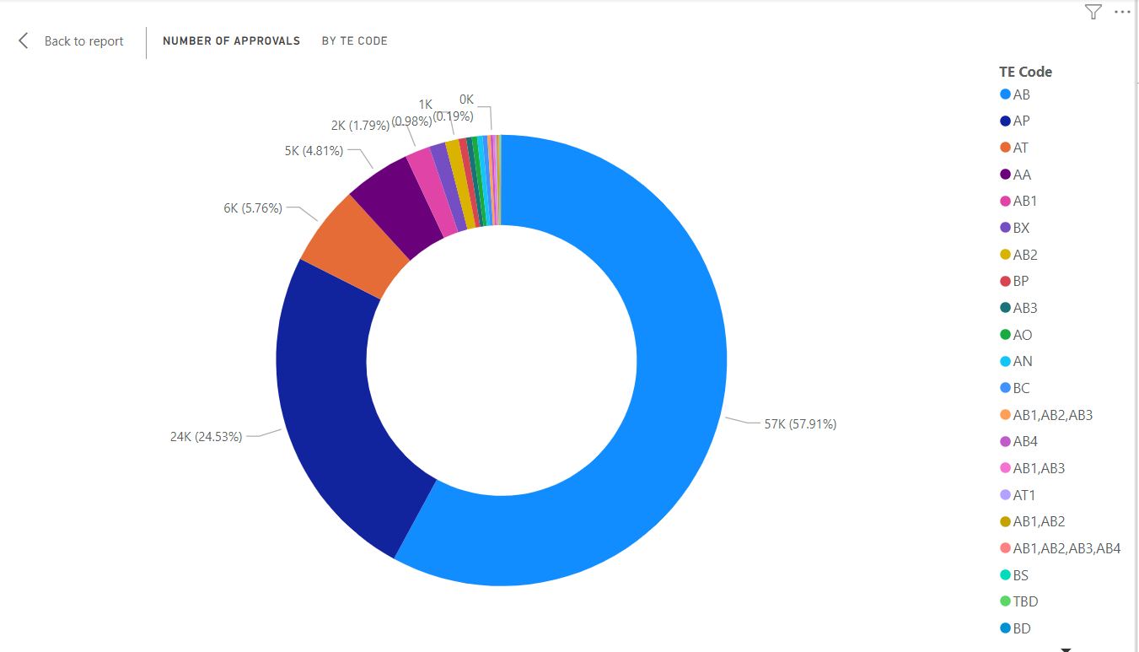
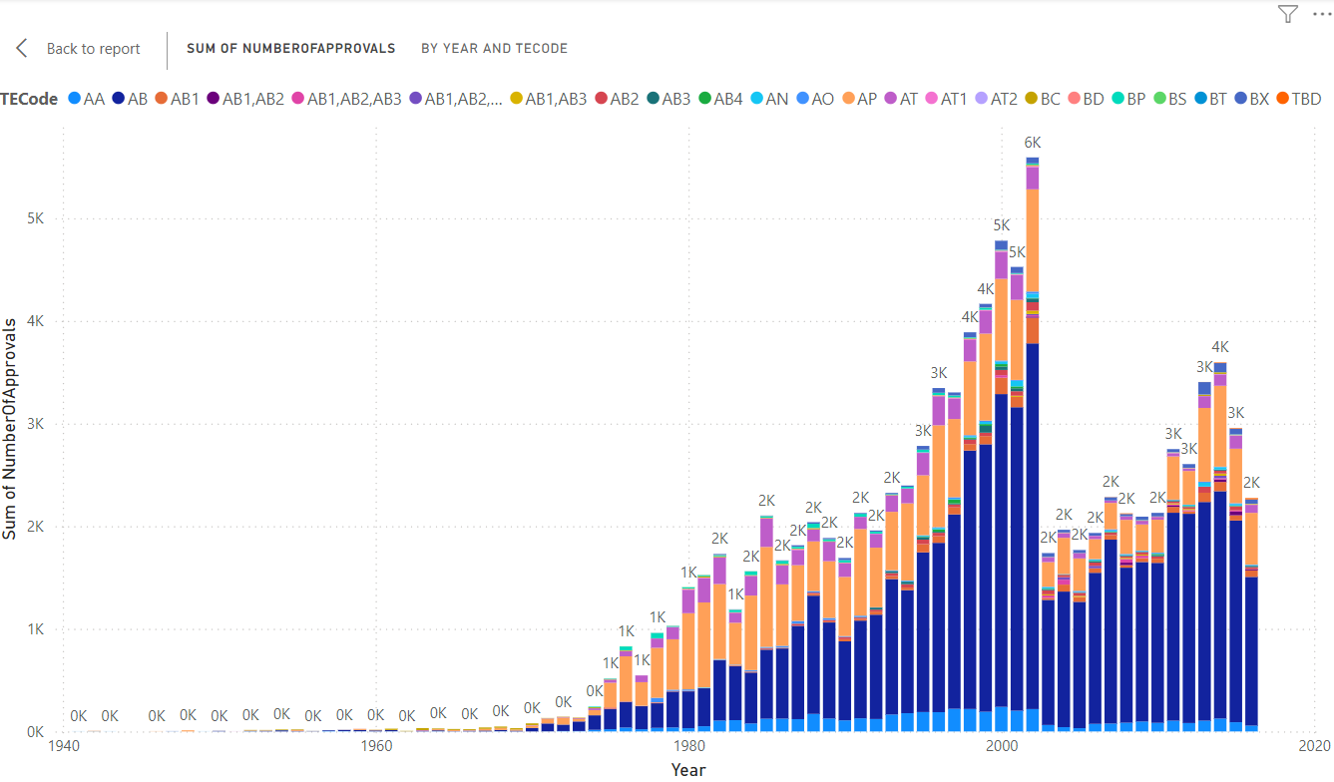
Drug Approvals Based On Therapeutic Classes.
57.91% of the drugs pertaining to AB class have been cleared
The highest no of approvals i.e 3563 were done in year 2002 for AB class

Slide 8
THANK YOU

